Slide 1
To Do List

Slide 2

Team Members
30. Ashish Yadav
05. Atreya Ganguly
13. Harshit Mishra
14. Mitesh Munankar
Technologies Used
MySQL, PHP, JavaScript
Project Guide
Prof. Dhananjay Raut
Project Genre
Web Based Project

Slide 3

What is a to-do list
They list everything that you have to do, with the most important tasks at the top of the list, and the least important tasks at the bottom. By keeping such a list, you make sure that your tasks are written down all in one place so you don't forget anything important.

Slide 4
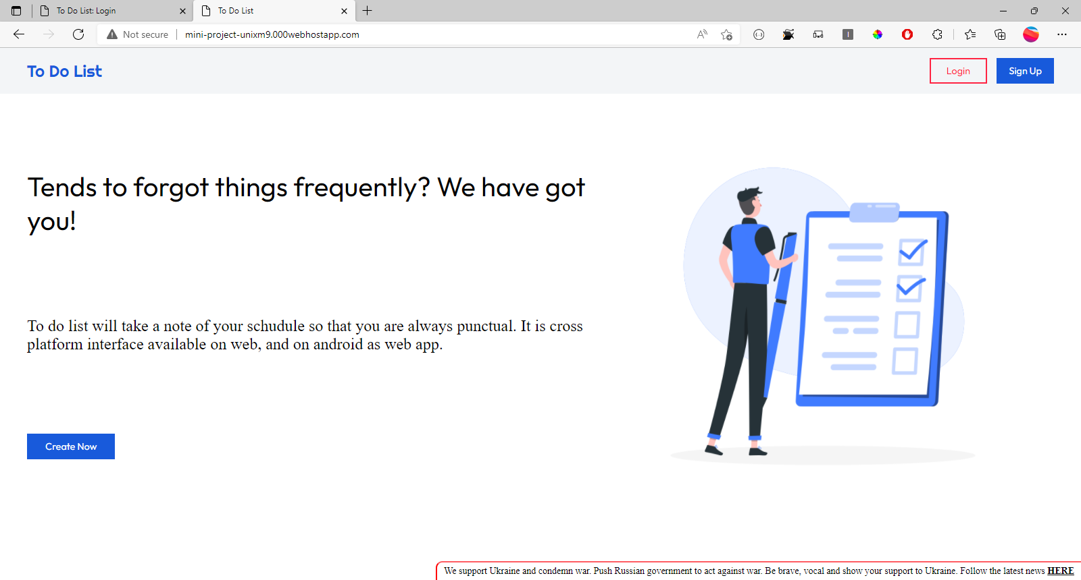

Slide 5
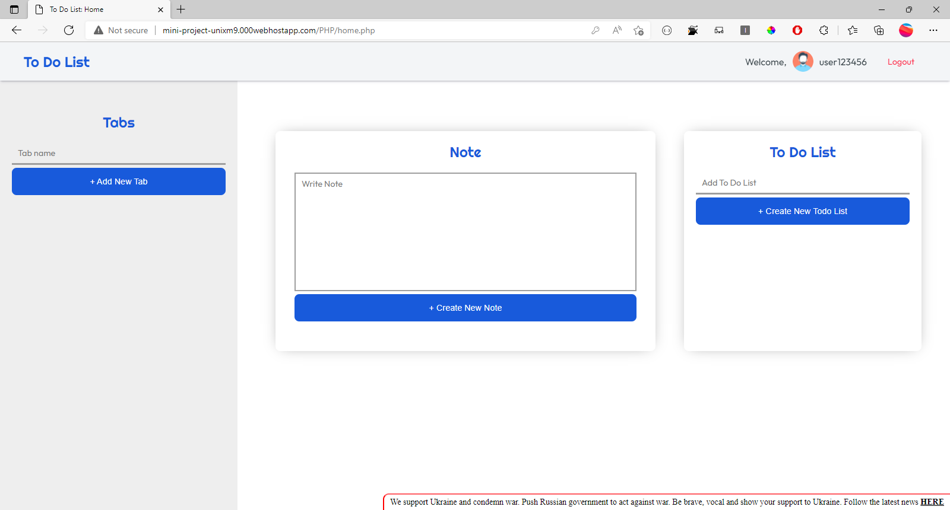

Slide 6
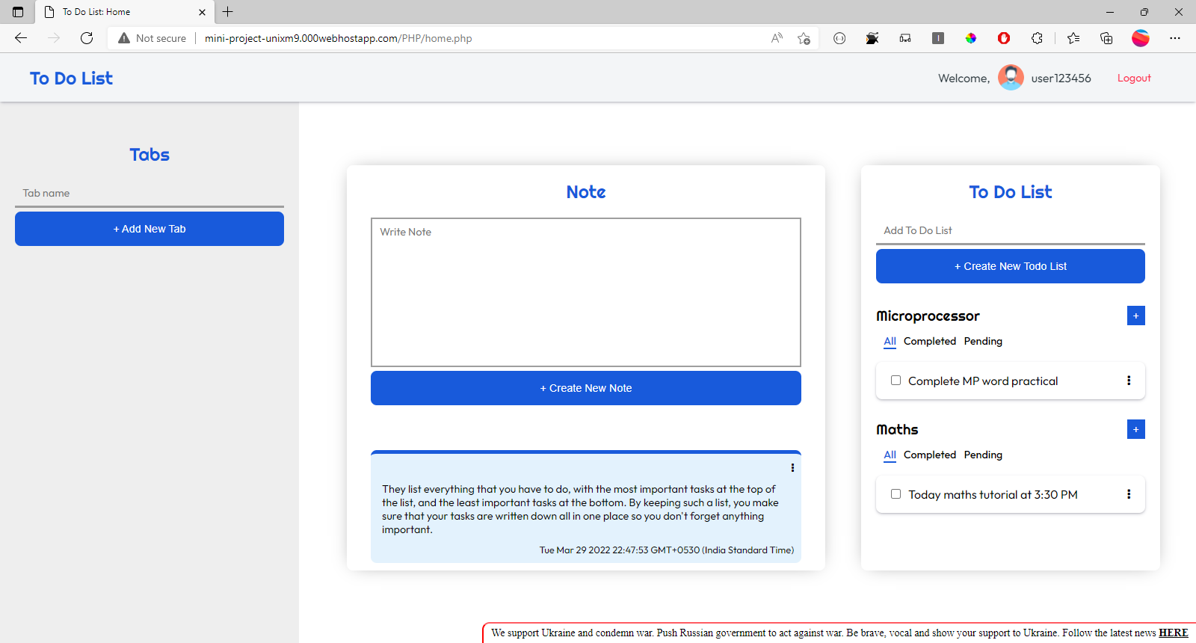

Slide 7


Slide 8
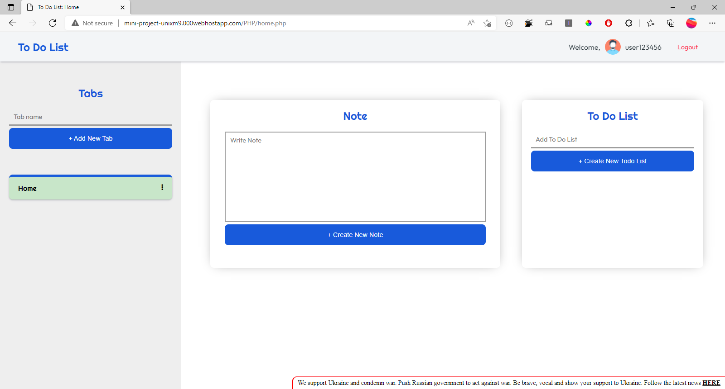

Slide 9


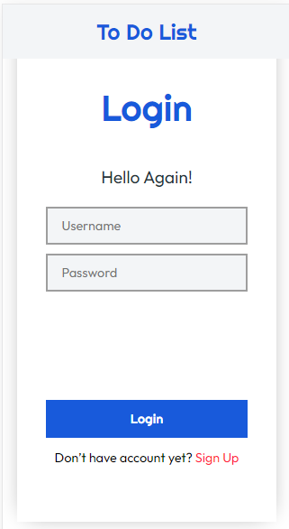
http://mini-project-unixm9.000webhostapp.com/

Slide 10
Alternate Topics
Bus Reservation System in Java
College Predictor Website

Slide 11
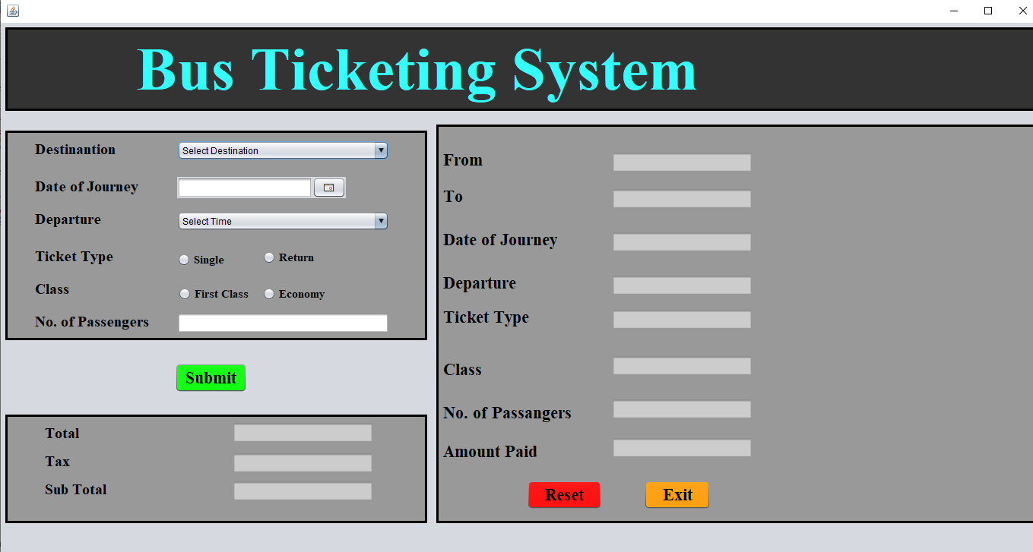

Slide 12
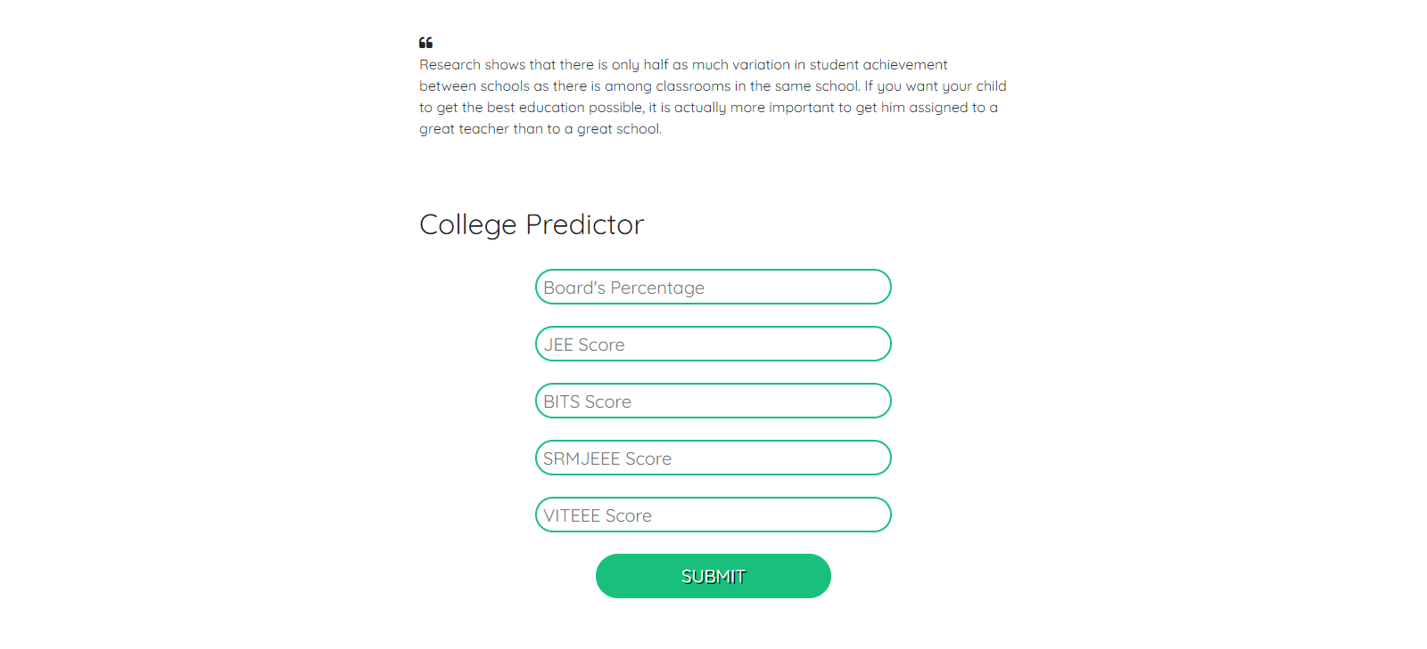
College Predictor Website

Slide 13
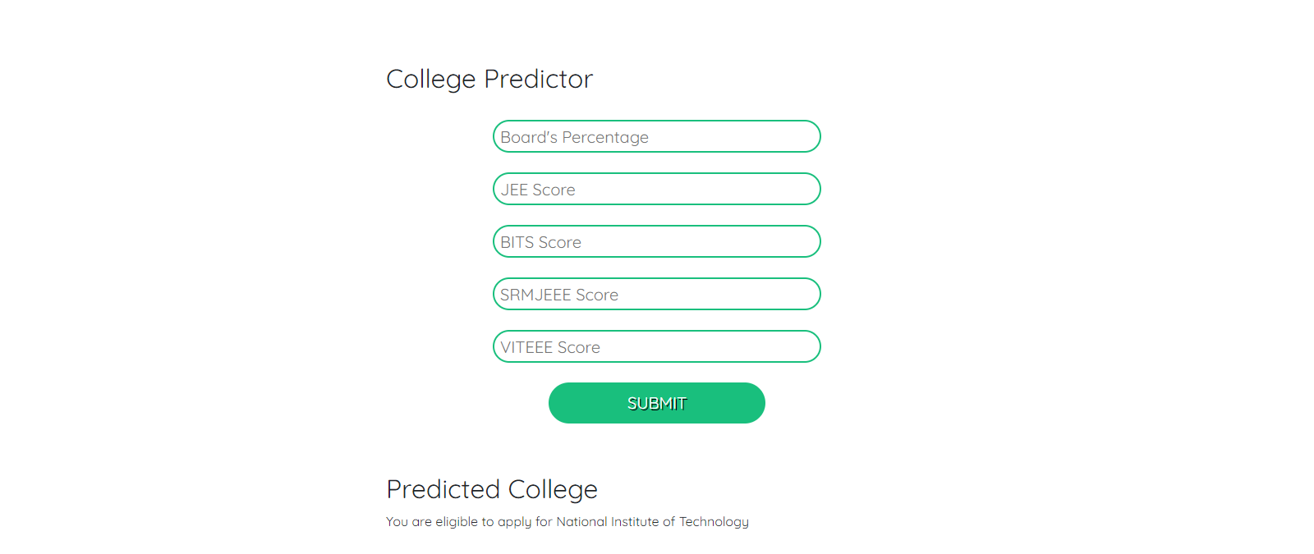
College Predictor Website

